Slide 1
Title:
The Changing Landscape of Rent, Income, and Homeownership in England
Goal :
The goal is to examine the changing landscape of homeownership and renting, analyze regional differences, and discuss recommendations to improve housing affordability.
Data Sources:
Private rental affordability 2022 England Wales
Household-characteristics-by-tenure-england-and-wales-census-2021
Notes:
I’ll will be exploring key trends in rent, income, and homeownership in England and Wales.
The insights gotten from these visuals will help us understand affordability challenges and potential solutions.

Slide 2
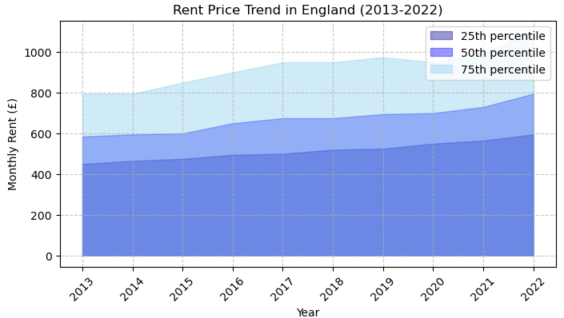
Act 1: The Cost-of-Living Challenge
Key Insights:
Rent prices have consistently increased over the years, with notable rises in the upper quartiles.
The gap between the 25th, 50th, and 75th percentiles has widened slightly, suggesting that higher-end rentals are increasing at a faster rate.
Post-2020, rent prices appear to have risen more sharply, possibly due to economic changes and housing demand shifts.
Fig 1. Shows a Stacked Area Graph of the rent price trend for England from 2013 to 2022. Showing how rent prices have changed over time across the different quartiles.
Notes:
It represents the monthly rent (£) for different percentiles:
25th percentile (light purple): Represents the lower range of rent prices.
50th percentile (medium purple): Represents the median rent prices.
75th percentile (light blue): Represents the higher range of rent prices.

Slide 3
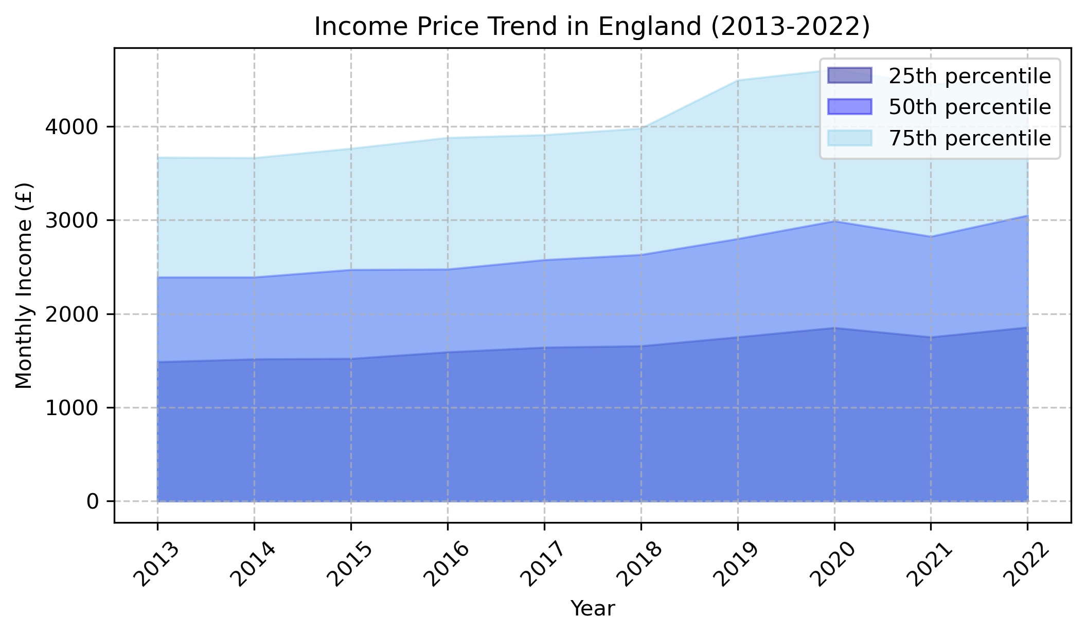
Key Insights:
Income has increased over time across all quartiles, though the rate of increase varies.
Higher-income earners (75th percentile) have seen a more consistent rise in income, while lower-income earners (25th percentile) have experienced a slower growth rate.
The gap between income quartiles has widened slightly, which may indicate increasing income inequality.
Fig 2. Shows a Line Area Graph of the income trend for England from 2013 to 2022. Showing how income have changed over time across the different quartiles.
Notes:
It represents the monthly Income (£) for different percentiles:
25th percentile (light purple): Represents the lower range of Income.
50th percentile (medium purple): Represents the median Income.
75th percentile (light blue): Represents the higher range of Income.

Slide 4
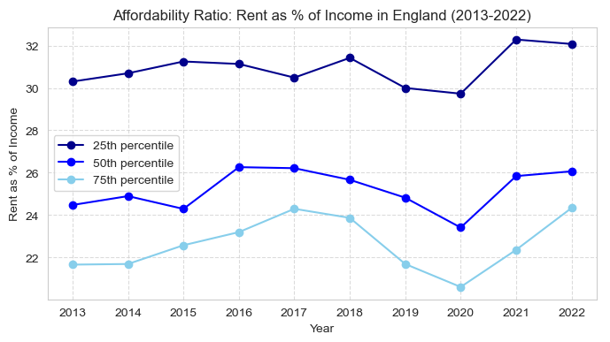
Key Insights:
Lower-income renters (25th percentile) consistently spend a higher proportion of their income on rent, indicating affordability challenges.
The percentage has increased over time for all income groups, showing that rent growth has outpaced income growth.
The gap between quartiles has widened slightly, suggesting that lower-income renters are being disproportionately affected.
Fig 3. Show a Line Graph of the affordability ratio in England. Displaying rent as a percentage of income for different income quartiles in England from 2013 to 2022.
Notes:
To Conclude this section
Over the past decade, rent prices have consistently increased, with sharper spikes post-2020. While incomes have grown, they have not kept pace, making housing affordability a growing concern.
“Lower-income households are at the brunt of the situation as they spend a significantly higher percentage of their earnings on rent, leaving them financially vulnerable

Slide 5
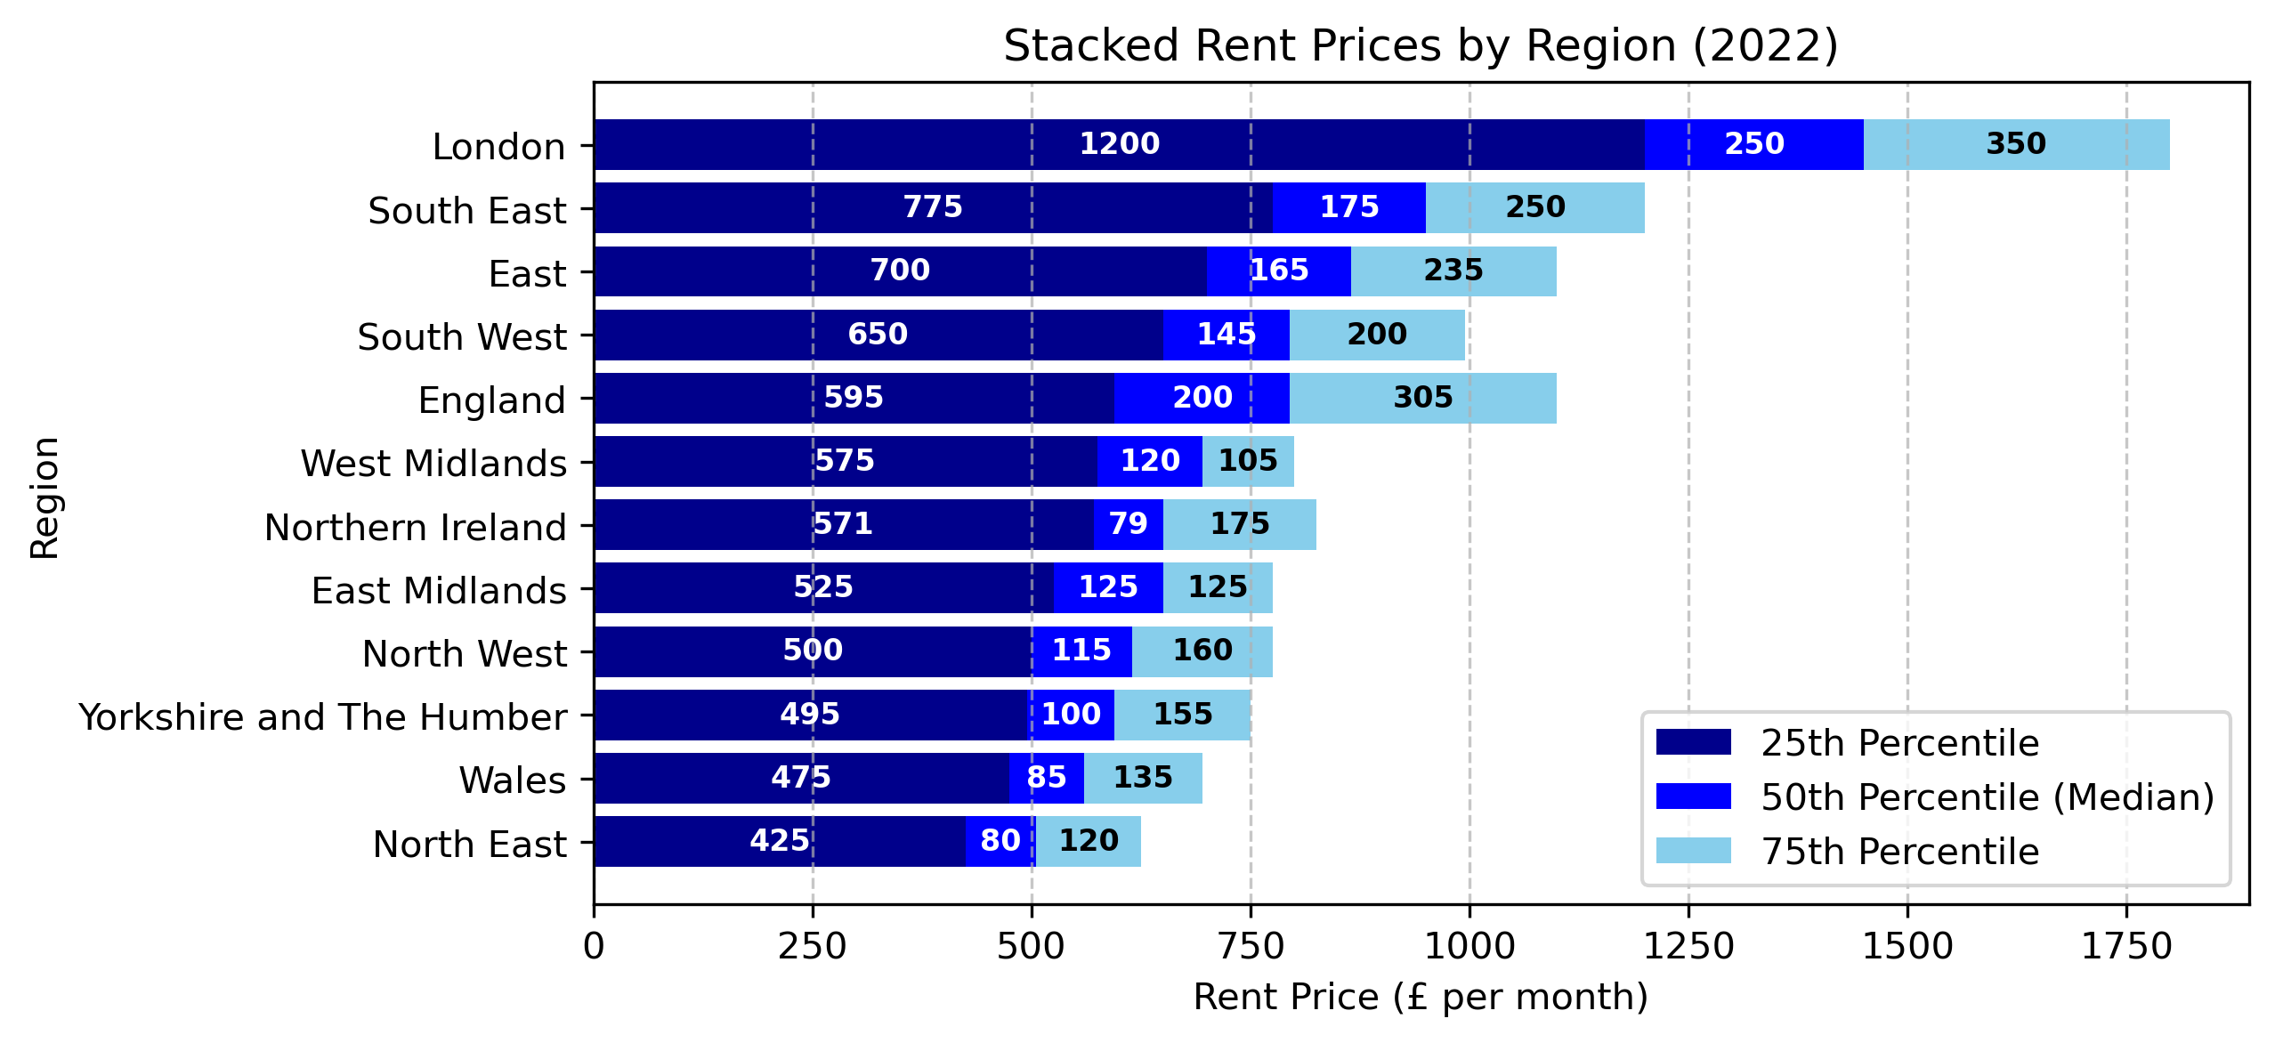
Act 2: The Regional Divide
Key Insights:
London has the highest rent prices across all percentiles, with a significantly larger gap between the 50th and 75th percentiles.
Regions in the South East, East of England) also have relatively high rents, though more evenly distributed.
The North East and North West remain the most affordable regions, with all percentiles positioned lower.
England’s overall rent values are in the mid-range, capturing the national average.
Fig 4. Shows a Stacked Bar Chart of the 25th, 50th (median), and 75th percentile rent prices by region for 2022, including England and Wales
Notes:
This section examines Rent Prices, Income Earners & household tenure types by Region (Wales inclusive)
This chart is a stacked bar chart showing rent prices by region in 2022. It breaks down rent costs into three categories:
25th percentile (dark blue): Represents the lower range of rent prices.
50th percentile (medium blue): Represents the median rent price.
75th percentile (light blue): Represents the higher range of rent prices.

Slide 6
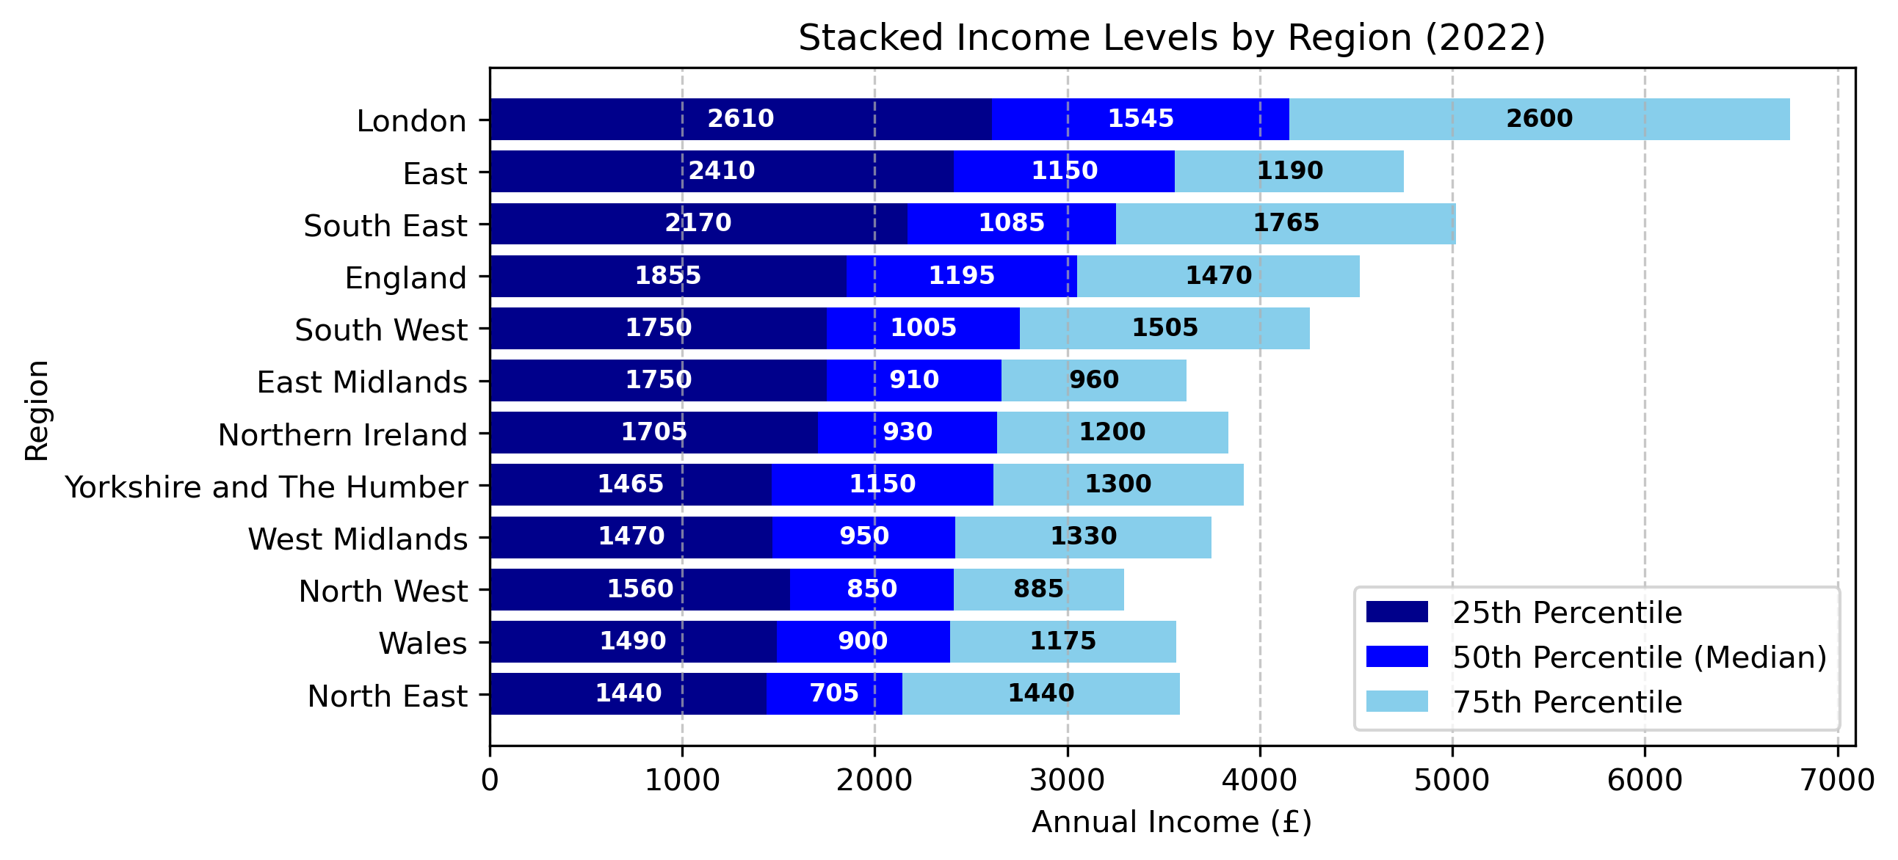
Key Insights:
London has the highest income levels across all percentiles, with a noticeable jump at the 75th percentile.
The South East and East of England also show relatively high income levels, consistent with higher rent costs in these regions.
The North East and North West have the lowest income levels, which aligns with their lower rent prices.
England’s overall income levels sit in the mid-range, capturing a national average.
Fig 5. Shows a Stacked Bar Chart of the 25th, 50th (median), and 75th percentile Income by region for 2022, including England and Wales.
Notes:
This chart is a stacked bar chart showing rent prices by region in 2022. It breaks down Income earners into three categories:
25th percentile (dark blue): Represents the lower range of Income earners.
50th percentile (medium blue): Represents the median Income earners.
75th percentile (light blue): Represents the higher range of Income earners.

Slide 7
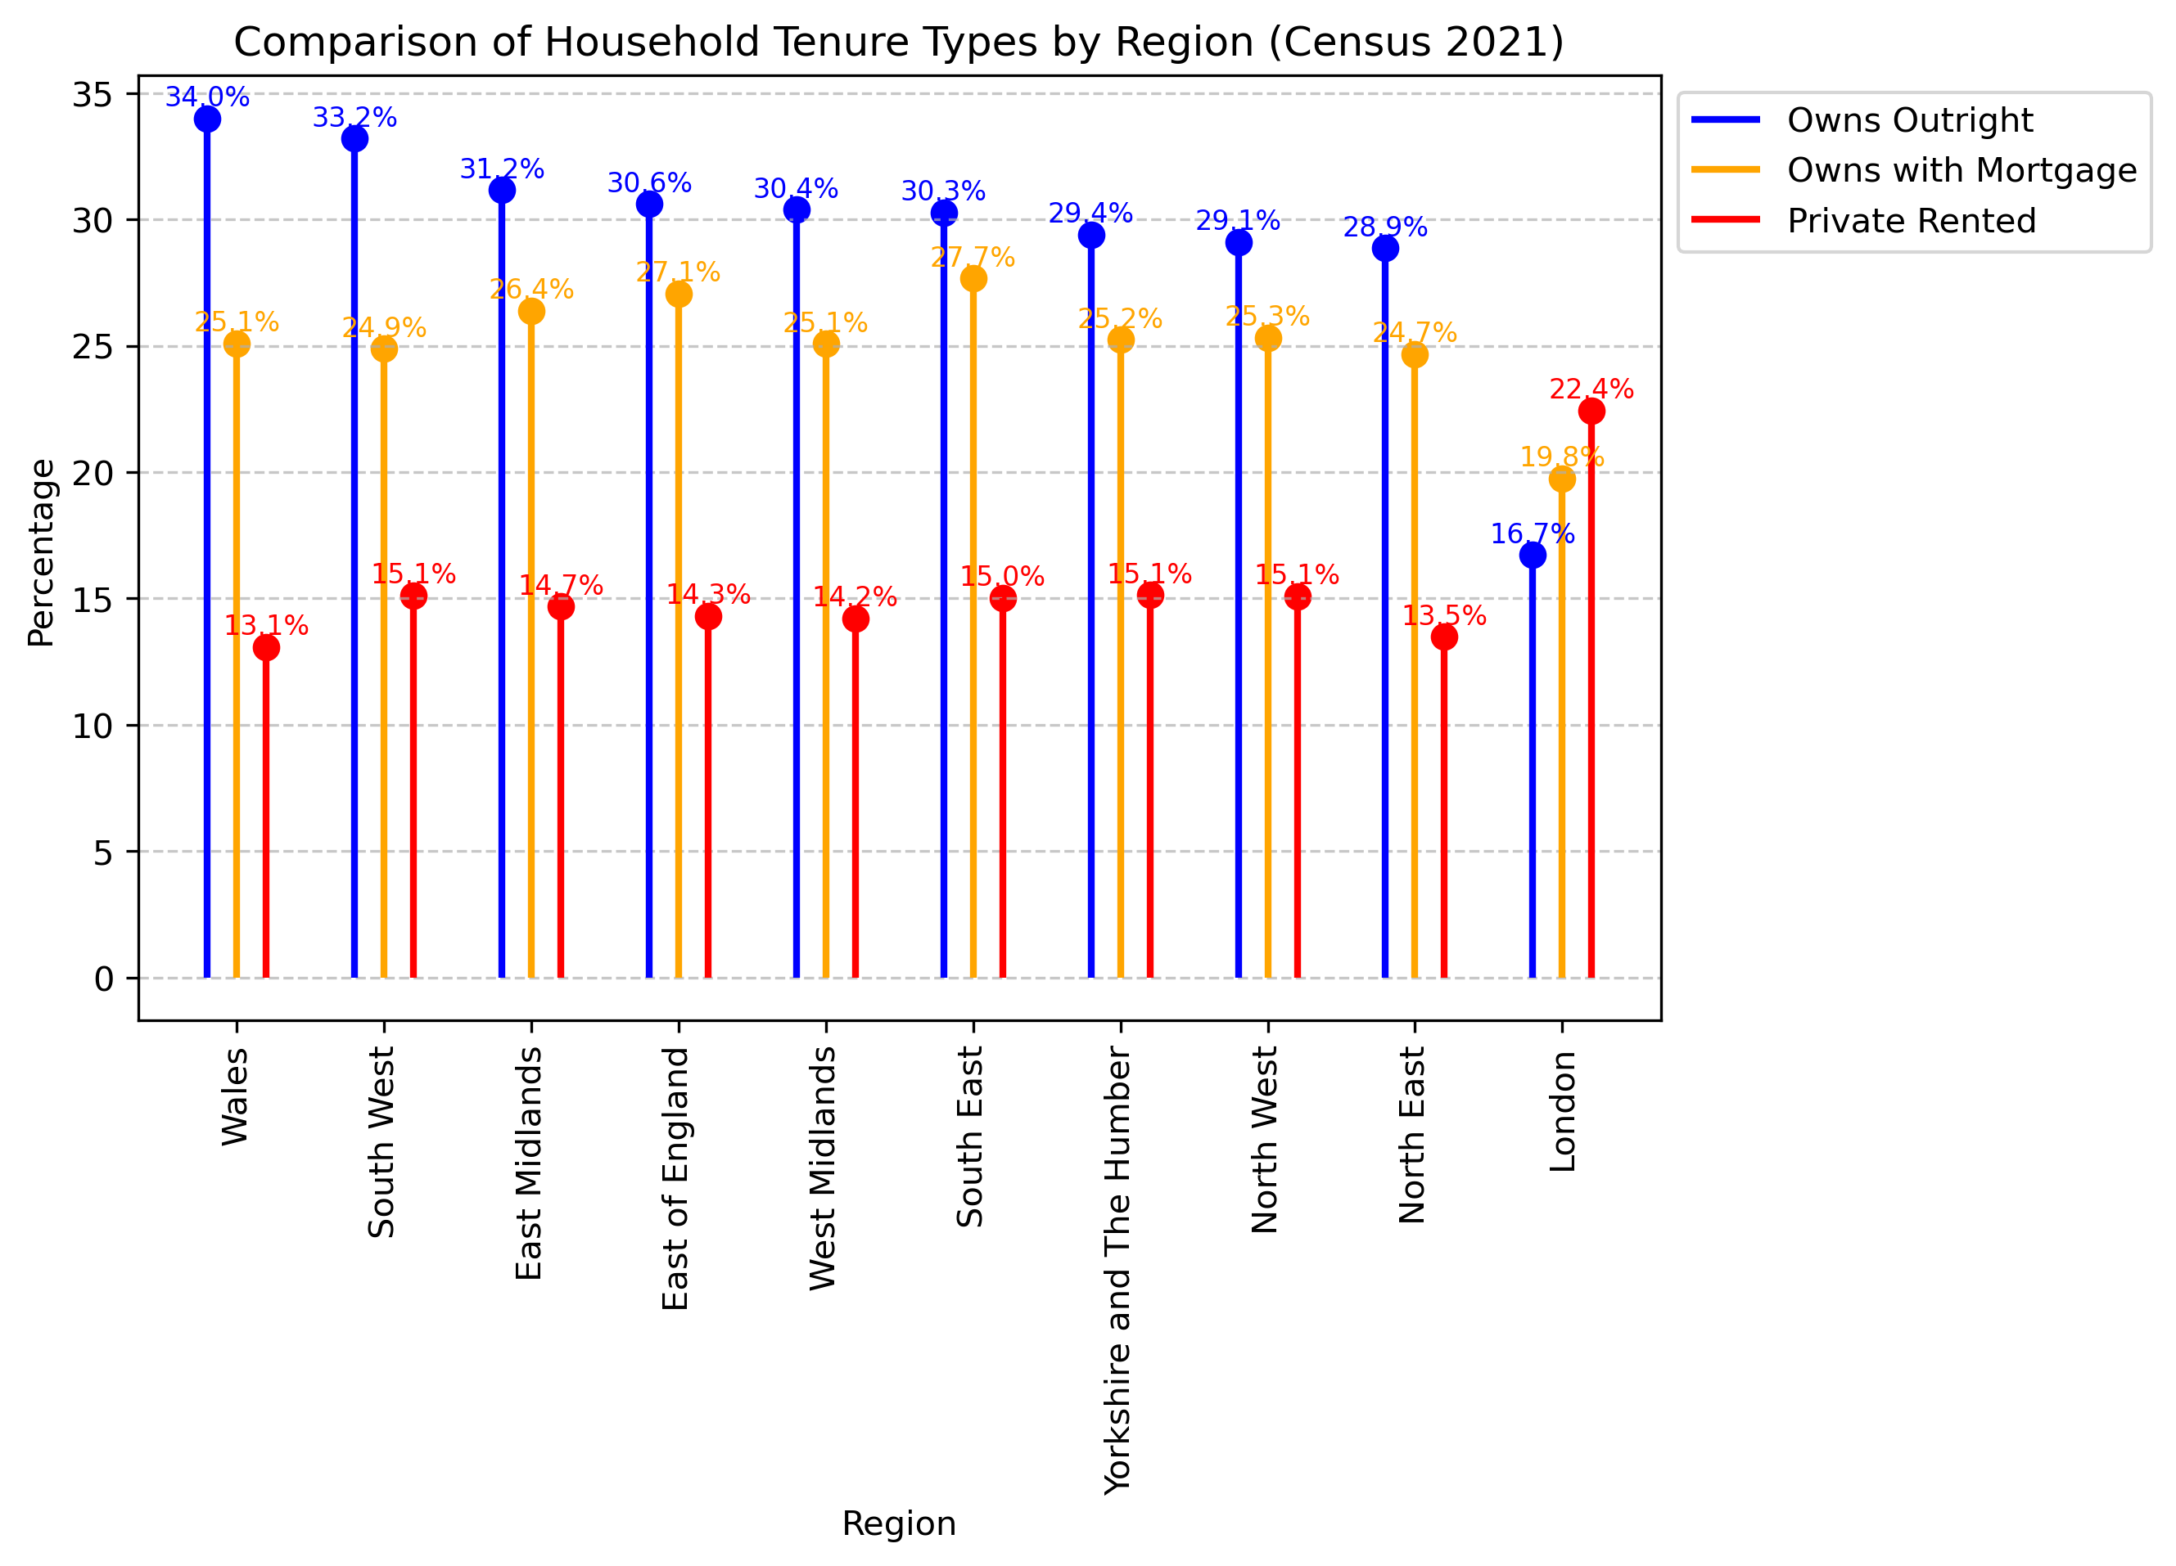
Key Insights:
Wales and South West have the highest percentage of households that own their homes outright (above 30%).
London has the lowest outright homeownership (16.7%) but the highest private rental percentage (22.4%), reflecting high housing costs and reliance on the rental market.
Mortgage ownership is relatively consistent across regions, with percentages mostly between 24% and 27%.
Private renting is significantly lower in regions outside of London, typically around 13-15%
Fig 6. Lollipop Chart showing the comparison of household tenure types by region for 2022, including Wales.
Notes:
It shows three different tenure categories across multiple regions in the UK:
Owns Outright (Blue) – Represents the percentage of households that fully own their home without a mortgage.
Owns with Mortgage (Orange) – Indicates the percentage of households that own their home but are still paying a mortgage.
Private Rented (Red) – Shows the percentage of households that rent privately.
London’s low ownership numbers & high renting than other parts of England are likely as a result of several reasons including high property prices, limited housing supply & a growing population

Slide 8
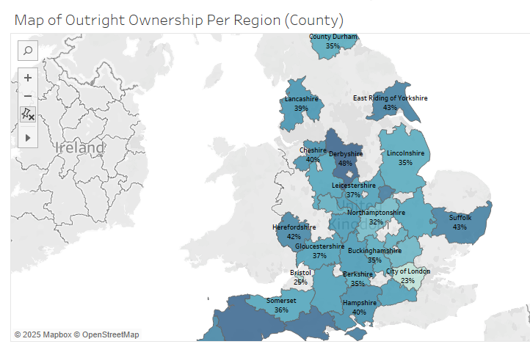
Key Insights:
Geographic Trends in Outright Homeownership
High Ownership Areas:
Derbyshire (48%), Dorset (46%), Cornwall (47%), and Isle of Wight (44%) have some of the highest outright ownership percentages.
These regions might have an older population, a higher number of retirees, or a culture of purchasing homes outright.
Coastal and rural areas like Dorset and Cornwall are traditionally known for high outright ownership due to retirement migration.
Low Ownership Areas:
City of London (23%) and Bristol (25%) have the lowest outright homeownership rates.
Urban areas often have higher property prices, making mortgage financing a more common option.
A younger population, job mobility, and a high proportion of rented housing contribute to lower outright ownership in these locations.
Urban vs. Rural Divide
Rural counties such as Dorset, Cornwall, and Derbyshire have higher outright ownership rates, likely due to lower property prices and more retirees.
Urban areas like City of London and Bristol have lower outright ownership rates, driven by expensive housing markets, high rental populations, and younger demographics.
Fig 7. Shows a Layered Map of outright ownership by counties in the England
Notes:
This map displays the % of outright ownership across various counties in England
The darker shades indicate higher outright ownership percentages, while lighter shades indicate lower ownership levels.
The map uses regional boundaries to represent different counties, and percentages are labelled to show outright homeownership rates.
To conclude we can say Regions has some impact on Rent Prices, Income Earners & household tenure types

Slide 9
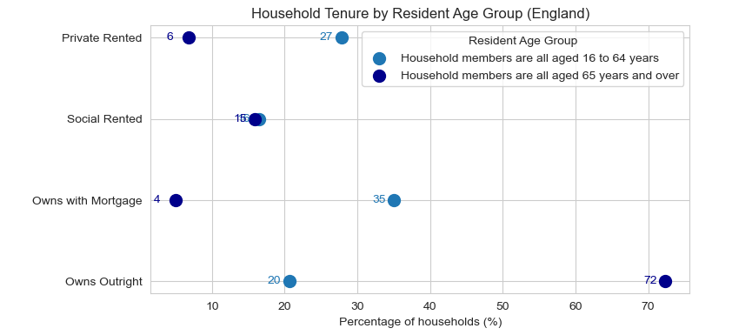
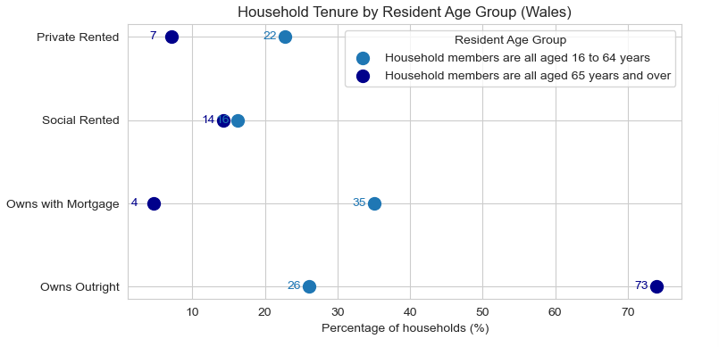
Act 3: Homeownership Trends by Age, Ethnicity, Family Size & Composition
Key Insights :
England:
High Outright Ownership Among Older Households:
72% of households where all members are aged 65+ own their homes outright, compared to just 20% for younger households (16-64 years).
Higher Mortgage Dependence in Younger Households:
35% of younger households in England own homes with a mortgage, compared to just 4% for older households.
Private Renting is More Common Among Younger Households:
27% of younger households rent privately, while only 6% of older households do.
Social Housing Usage is Similar:
Social renting is relatively close for both groups, with 16% for younger and 15% for older households
Wales:
Slightly Higher Outright Ownership for Older Households:
73% of older households in Wales own their homes outright, slightly higher than England (72%).Among younger households, outright ownership is at 26%, higher than England's 20%.
Similar Mortgage Dependence:
35% of younger households in Wales own homes with a mortgage, identical to England.
However, only 4% of older households in Wales have mortgages, mirroring the trend seen in England.
Private Renting Slightly Lower Among Young Households:
22% of younger households rent privately in Wales, lower than England's 27%.
This could suggest slightly better housing affordability in Wales.
Social Renting More Common in Wales:
16% of younger households and 14% of older households rent from social housing, which is slightly like England.
Figure 8a & 8b Shows a Scatter plot of Household Tenure by Resident Age in England and Wales
Notes:
This section examines the Resident age groups, Ethnicity, Family size & Composition in England and Wales
Resident age was categorised into 2 groups:
Shown as the blue & dark blue dots
Household Tenure was categorized into : Owns outright, Owns with Mortgage, Social Rented & Private Rented

Slide 10
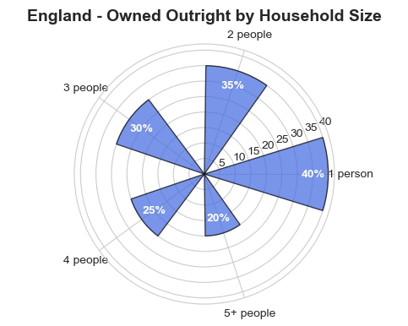
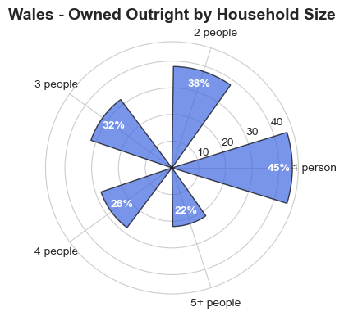
Key Insights
General Trend Across Household Sizes
In both England and Wales, the percentage of households owned outright decreases as the household size increases.
Single-person households have the highest outright ownership rates, while larger households (5+ people) have the lowest.
England vs. Wales - Key Differences
Wales has a higher outright ownership percentage across all household sizes compared to England.
The gap between England and Wales is more noticeable in single-person and two-person households, where Wales leads by 5 and 3 percentage respectively.
Single-Person and Two-Person Households Dominate Ownership
Single-person households:
England: 40%
Wales: 45%
Many of these may be retirees or older adults who have paid off their mortgages.
Two-person households:
England: 35%
Wales: 38%
This group likely includes couples who have lived in their homes for many years and paid off their mortgages
Fig 9. Shows Radial Bar Charts comparing owned outright tenure to household size in England and Wales
Notes:
Household size were categorised in 5 groups showing round the chart
The bars indicates the percentage of outright ownership
These insights suggests that smaller households have higher homeownership rates. Single & 2 household are more likely to own their homes outrightly
Larger Households Depend More on Mortgages or Renting. Suggesting Larger households, often families with children, may face greater financial strain, especially in high-cost regions

Slide 11
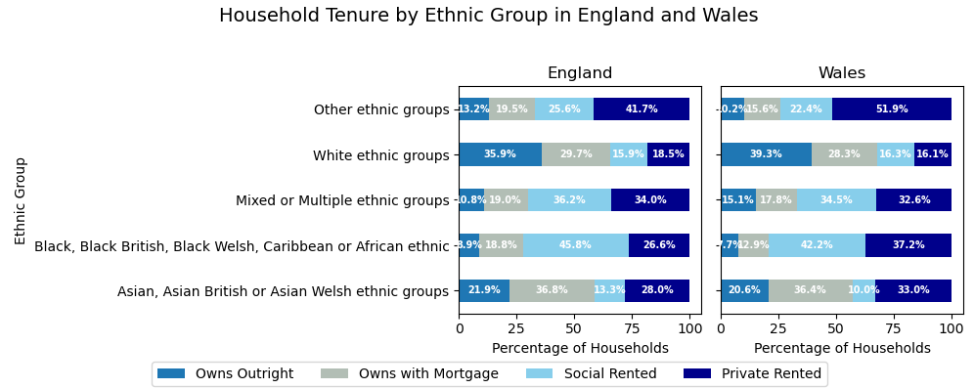
Key Insights:
Homeownership Trends:
Higher among White British households, indicating generational wealth and financial stability.
Lower among minority ethnic groups (e.g., Black African communities), likely due to income disparities and migration patterns.
Mortgage vs. Outright Ownership:
White British households have higher outright ownership.
Ethnic minorities (e.g., Asian/British Asian) rely more on mortgage-based ownership.
Private Renting Trends:
Black African and other minority groups have higher private renting rates.
White British households show a lower preference for renting, favouring ownership.
England vs. Wales:
Higher homeownership in Wales (especially among White groups) due to lower property prices.
More renting in Wales for some ethnic groups, possibly due to housing policies or affordability.
Fig 10. Shows a 100% Stacked Bar Chart comparing household tenure by ethnic group in England and Wales
Notes:
Ethnic Groups were categorised into:
Each bar is stacked to show the proportion of households in different ethnic groups
There are significant disparities in homeownership, mortgage dependency, and renting patterns among ethnic groups in both England and Wales.
White British households have the highest ownership rates, while Black African and other minority groups are more likely to rent.

Slide 12
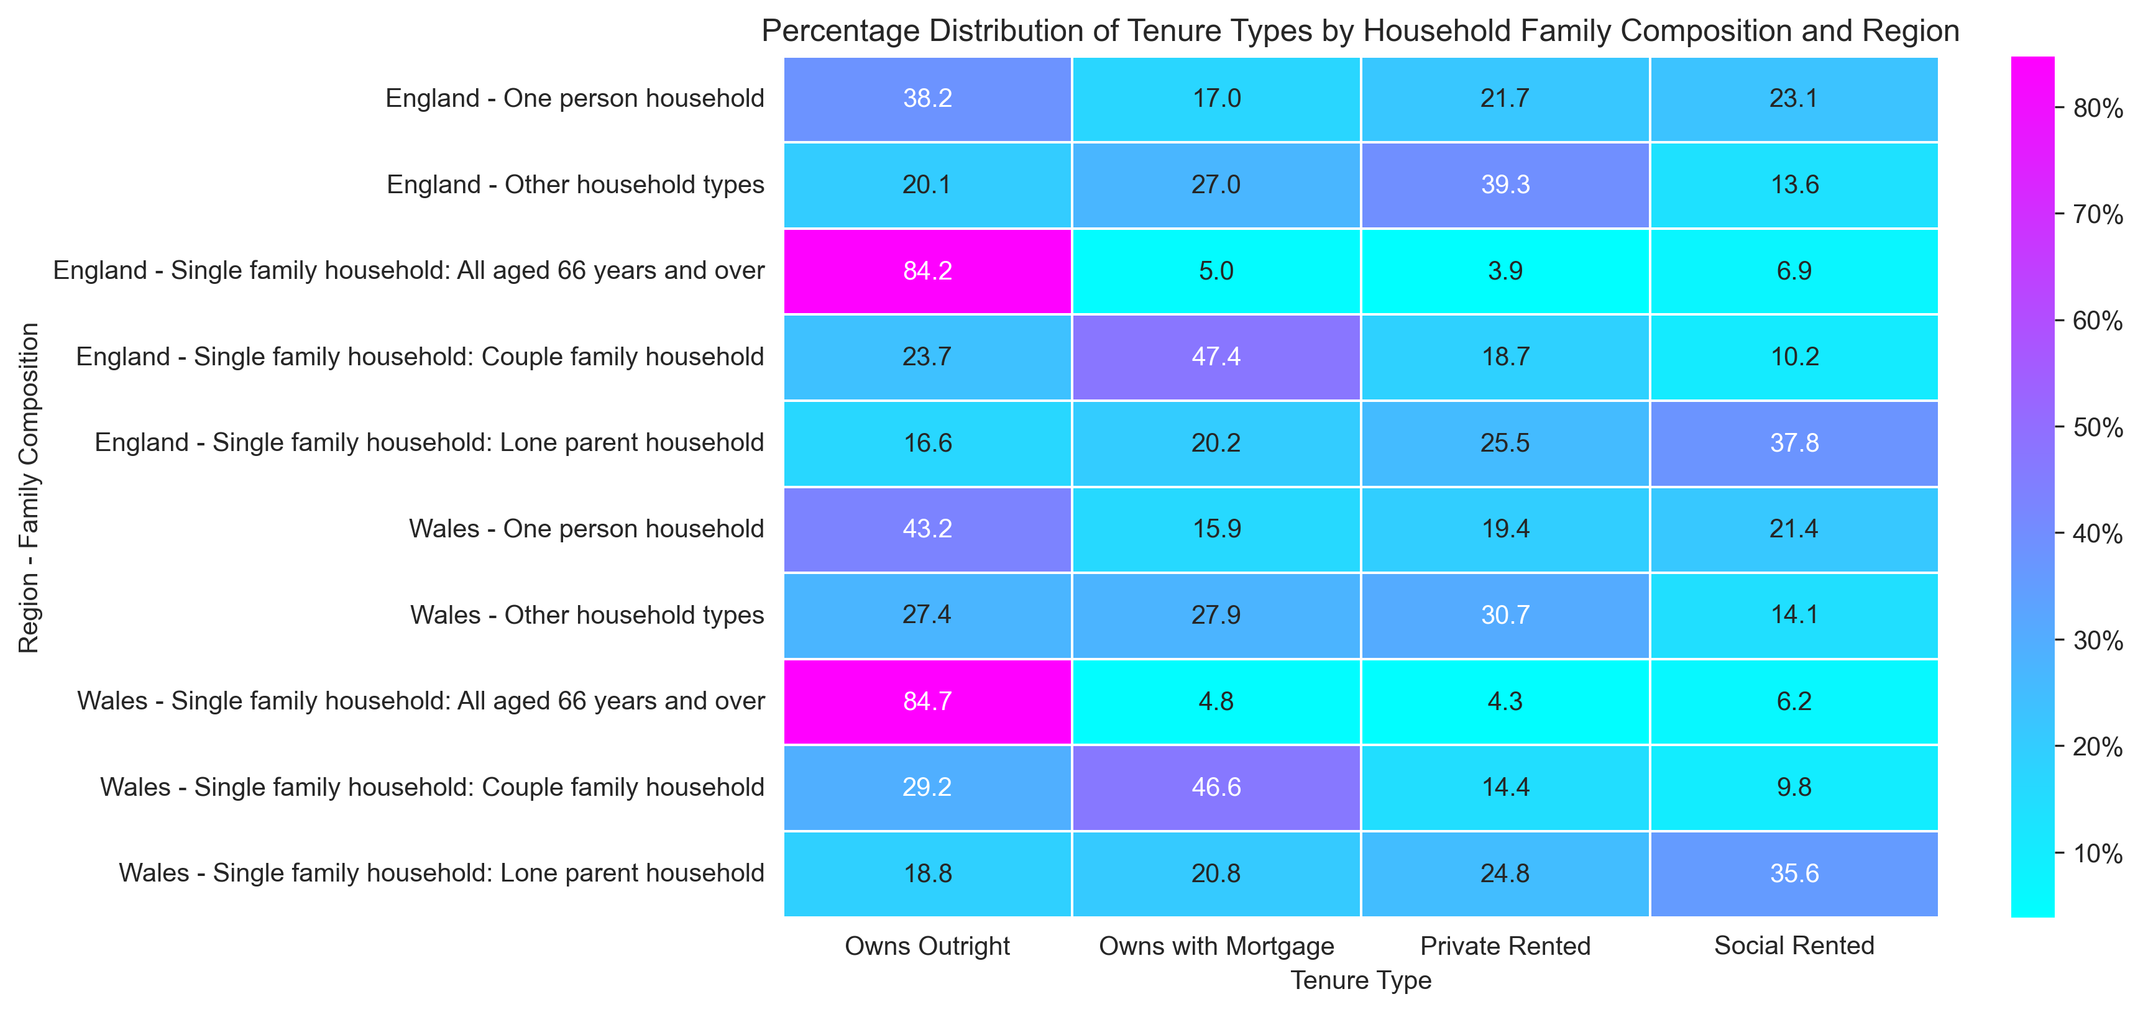
Key Insights:
Homeownership Trends:
Outright ownership is highest among elderly couples and retirees, especially in aging regions.
Mortgaged ownership is more common in younger families with children, indicating ongoing loan repayments.
Renting Patterns:
Social renting is higher among single parents and low-income families, especially in urban and lower-income areas.
Private renting dominates among young professionals, cohabiting couples, and students, particularly in high-cost urban areas.
Regional Differences:
Affluent regions have higher homeownership rates and fewer renters.
Urban areas have more renters due to high property prices, while rural areas see greater homeownership.
Socioeconomic Influences:
Social housing policies impact rental rates, with higher social renting where support is strong.
Younger generations face greater homeownership challenges due to rising property costs and economic uncertainty.
Fig 11. Shows a colour-coded Heatmap of the percentage distribution Tenure Types by Family composition and Region in England and Wales
Notes:
Family composition was categorised into:
The darker shades indicate higher Tenure type percentage, while lighter shades indicate lower Tenure type levels.

Slide 13
Challenges to Highlight:
Affordability crisis for younger and larger households
Rising rent and mortgage burdens for families
Disparities in homeownership by region and demography
Recommendations for Addressing Housing Affordability Challenges
1. Increase Affordable Housing Supply
2. Improve Rent Control and Tenant Protection
3. Support First-Time Homebuyers
4. Address Income Disparities
5. Regional Policy Adjustments
6. Encourage Long-Term Solutions
Conclusion:
Key Takeaways: Housing affordability is a growing issue, especially for larger families and younger individuals. Regional and demographic disparities highlight the need for targeted solutions.
The housing crisis is complex, but with targeted interventions, a balance between affordability and economic growth can be achieved. Collaboration between the government, private sector, and communities is essential to create sustainable housing solutions for the future.
Notes:
1. Expand public housing projects and incentivize private developers to build more affordable homes.
And Implement policies to repurpose vacant homes and buildings into affordable rental units
2. Introduce fair rent regulations to prevent excessive annual rent hikes.
Ensure legal protections against unfair evictions and provide longer lease options.
Increase housing support for low-income renters to keep pace with rising rent.
3. Expand access to low-interest mortgage programs for young and low-income buyers.
Promote alternative paths to homeownership to help renters gradually build equity. (Shared Ownership & Rent-to-Buy Schemes)
Reduce or eliminate stamp duty for first-time buyers in high-cost areas.
4. Ensure wages keep up with the rising cost of living. (Increase Minimum Wages)
Encourage businesses to establish offices in lower-cost areas to reduce housing demand in high-rent cities
5. Improve Infrastructure in Affordable Regions: Invest in public transport and digital connectivity to make less expensive regions more attractive.
Local Authority Support: Empower local governments to implement housing policies tailored to their region’s needs.
6. Sustainable Housing Initiatives: Invest in eco-friendly housing solutions to reduce construction costs.
Public-Private Partnerships: Work with developers to ensure a percentage of new housing projects are designated as affordable.

